Slide 1
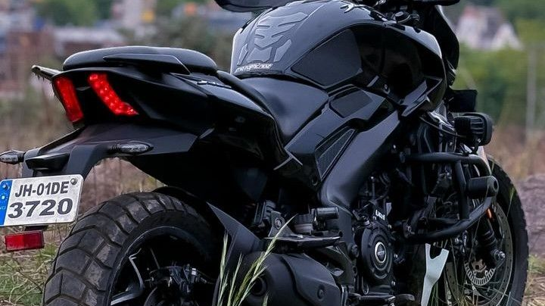
Impact of India’s Revised GST Policy on Bajaj Motorcycle Sales
Sales, Revenue & Forecast Analysis (2023–2025)
Excel project presentation By Sufiyan Mirkar-

Slide 2
OBJECTIVE
How GST is Steering the Future of Bajaj Motorcycles
This analysis aims to understand how India’s new GST policy has changed Bajaj motorcycle sales. It compares sales before and after the policy, identifies which segments and models gained or lost, and measures the overall impact on revenue and pricing. It also forecasts future demand so that Bajaj can plan production, pricing, and strategy with confidence.

Slide 3
📌 Scope of Analysis
Time Period Covered → Sales data up to Sept 2025 (pre-policy) and simulated post-policy data.
Focus Brand → Bajaj motorcycles only.
Comparison → Pre-policy vs Post-policy performance.
Metrics Studied → Units sold, revenue, average prices, and tax impact.
Segmentation → By engine capacity (Commuter ≤150cc, Mid 151–350cc, Premium >350cc) and by individual Bajaj models.
Exclusions → Other manufacturers and non-motorcycle segments are not considered.

Slide 4
METHODOLOGY
Data Collection
  Bajaj motorcycle sales dataset (till Sept 2025, pre-policy).
  Post-policy data simulated with revised GST rates.
Data Preparation
  Cleaned missing/duplicate values.
  Created segments based on engine capacity (Commuter ≤150cc, Mid 151–350cc, Premium >350cc).
  Added calculated fields: Revenue, Tax %, Pre vs Post comparison.
Exploratory Analysis
  Sales & revenue trends over time.
  Segment-wise and model-wise performance.
  Price & tax changes impact.
Comparative Analysis
  Pre-policy vs Post-policy differences in sales, prices, and revenue.
  Identified winners (growth) and losers (decline).
Visualization & Dashboards
  PivotTables & PivotCharts for segment/model insights.
  Interactive dashboards with slicers (Segment, Model, Period).
Insights & Recommendations
  Summarized key takeaways.
  Suggested production, pricing, and marketing strategies.

Slide 5

PROBLEM STATEMENTS
Which bike segments show a clear increase in demand post-policy, and should Bajaj scale up production in those categories?
Which segments are showing declining demand, and should Bajaj reduce production or reposition those models?
Which top 10 models gained the most sales after the policy, and should Bajaj prioritize marketing & dealership push for them?
Which models suffered the biggest sales drop post-policy, and should Bajaj introduce offers/finance schemes to protect their demand?
How much additional revenue was generated due to increased demand in commuter bikes?
What was the AVERAGE price change across segments?
Which segment faced the steepest tax hike, and does Bajaj need to adjust pricing/marketing strategies to retain buyers in that segment?

Slide 6
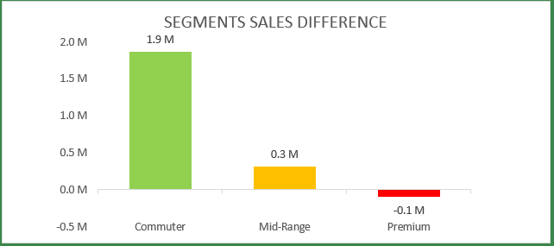
PROBLEM STATEMENT 1
Which bike segments show a clear increase in demand post-policy, and should Bajaj scale up production in those categories ?
The Commuter segment has the most increase in demand post-policy as shown in the chart,
Hence yes Bajaj should scale up the production in the commuter category!

Slide 7
PROBLEM STATEMENT 2
Which segments are showing declining demand, and should Bajaj reduce production or reposition those models?
The Premium segment has been in decline post-policy as shown in the chart,
Hence yes Bajaj should reduce the production in the premium segment or reposition these models!

Slide 8
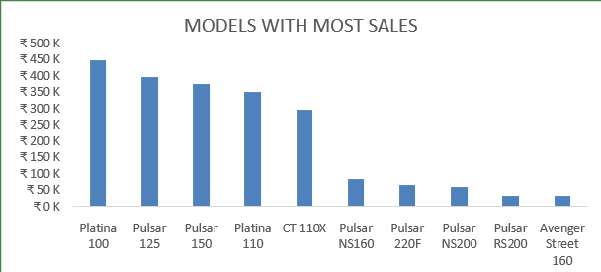
PROBLEM STATEMENT 3
Which top 10 models gained the most sales after the policy, and should Bajaj prioritize marketing & dealership push for them?
The following are the top 10 models of bikes by Bajaj which gained the most sales post-policy.
Yes Bajaj should prioritize marketing& dealership push for such models

Slide 9
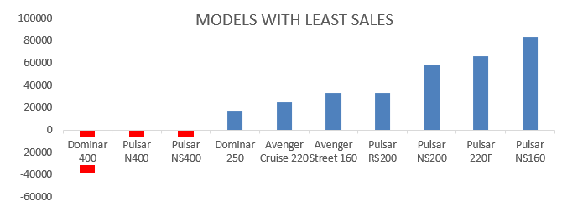
PROBLEM STATEMENT 4
Which models suffered the biggest sales drop post-policy, and should Bajaj introduce offers/finance schemes to protect their demand?
The following are the bottom 10 models of bikes by Bajaj which had the least sales post-policy.
Yes Bajaj should introduce offers/finance schemes to protect their demand.

Slide 10

PROBLEM STATEMENT 5
How much additional revenue was generated due to increased demand in commuter bikes?
With help of formulas in excel the additional revenue was calculated as “=[pre_policy_revenue]-[post_policy_revenue]”
After using the formula, the calculated additional revenue for commuter bikes is ₹ 76B

Slide 11

PROBLEM STATEMENT 6
What was the average price change across segments?
The average price change calculated for commuter is
-₹ 8,000
The average price change calculated for mid-range is
-₹ 14,357
The average price change calculated for mid-range is
₹ 28,600

Slide 12
PROBLEM STATEMENT 7
Which segment faced the steepest tax hike, and does Bajaj need to adjust pricing/marketing strategies to retain buyers in that segment?
As visualized in the following charts and kpi’s we can observe that the premium segment has the steepest and the only tax hike,
Yes Bajaj needs to adjust the pricing and the marketing strategies for the premium segment in order to retain buyers.

Slide 13
conclusion:
Policy Impact – The new GST policy significantly shifted demand: commuter and mid-segment bikes benefited, while premium bikes faced a slowdown.
Winners & Losers – Bajaj models like Pulsar 150 and Platina gained strong demand post-policy, while Dominar 400 and Avenger faced notable declines.
Revenue Trends – Despite price increases in premium bikes, total revenue grew mainly because of higher commuter sales volumes.
Pricing Sensitivity – Customers in the commuter segment are highly price-sensitive and responded positively to lower taxes, unlike premium buyers.
Strategic Takeaway – Bajaj needs to focus production on high-demand commuter and mid-segment models, while refining the premium strategy (e.g., value-add features, financing options, exports).

Slide 14
Thank You
Hope you have a great day ahead ☺

